Slide 1

Nonlinear ARX Identification
SYSTEM IDENTIFICATION 2023-2024
Project part 2
Petcuț Adrian-Axente
Ilea Cosmin-Ionuț
Szakacs Armand-Antonio
Group Id: 11

Slide 2
Table of contents:
Problem statement
Approximator Structure
Finding the parameters
Key features
Tuning Results
Plots for the optimal value
Conclusions
Code

Slide 3
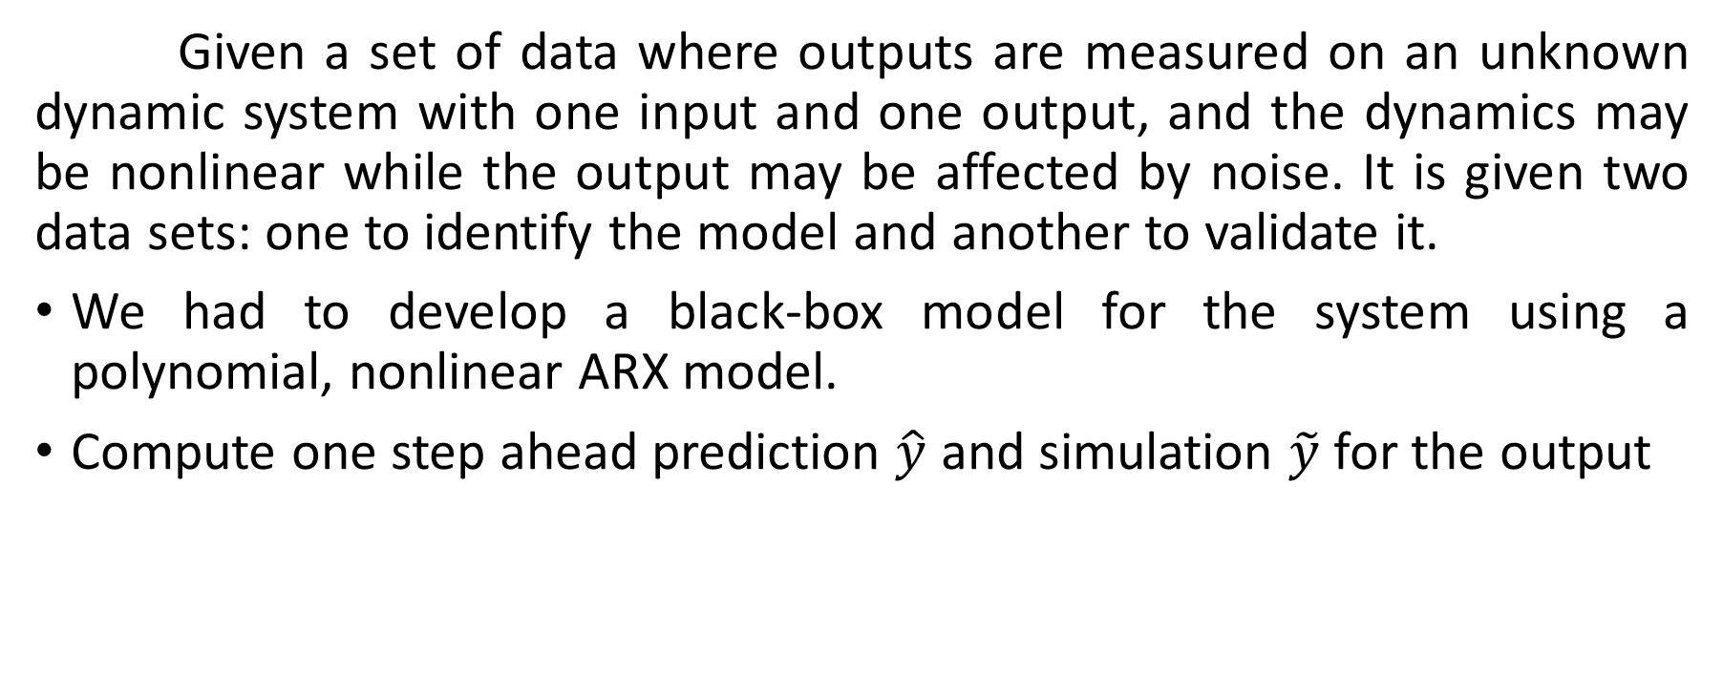
Problem statement
Given a set of data where outputs are measured on an unknown dynamic system with one input and one output, and the dynamics may be nonlinear while the output may be affected by noise. It is given two data sets: one to identify the model and another to validate it.
We had to develop a black-box model for the system using a polynomial, nonlinear ARX model.
Compute one step ahead prediction $\hat{y}$ and simulation $\tilde{y}$ for the output

Slide 4
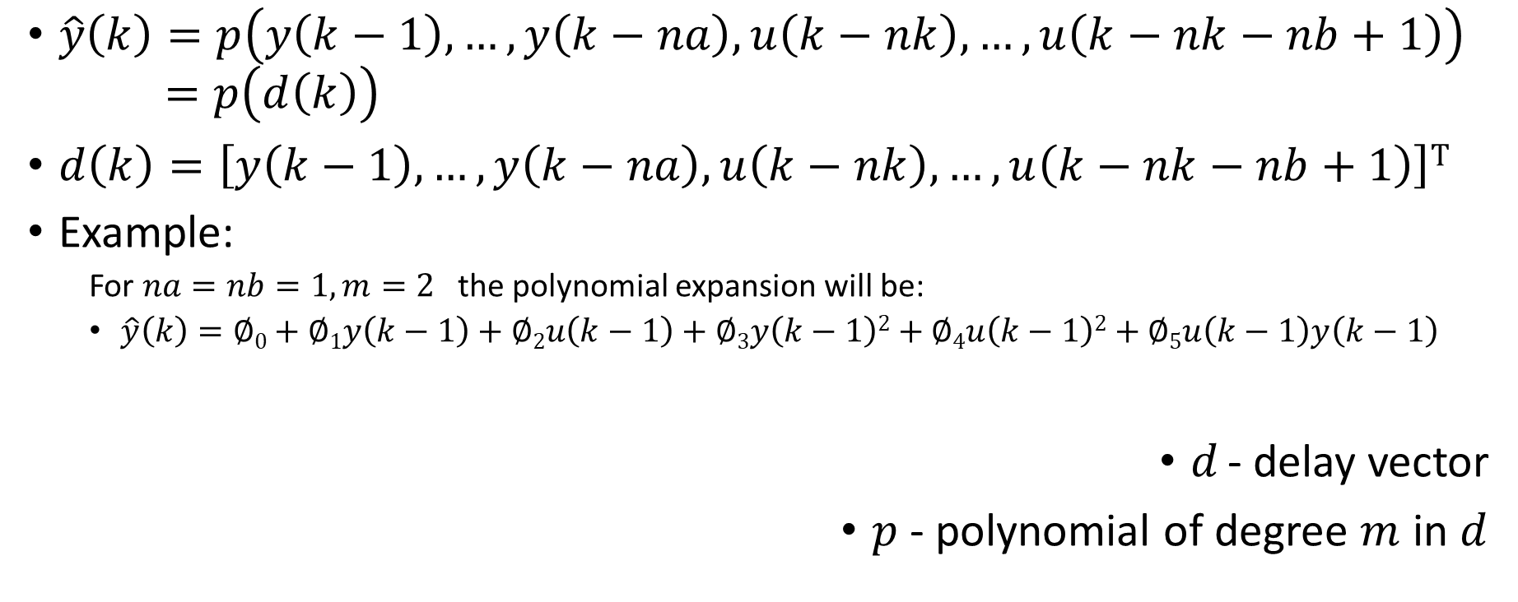
Approximator Structure
$\hat{y}\left(k\right)=p\left(y\left(k−1\right),…,y\left(k−na\right),u\left(k−nk\right),…,u\left(k−nk−nb+1\right)\right)$
$$=p\left(d\left(k\right)\right)$$
$d\left(k\right)=\left[y\left(k−1\right),…,y\left(k−na\right),u\left(k−nk\right),…,u\left(k−nk−nb+1\right)\right]T$
Example:
For $na=nb=1, m=2$the polynomial expansion will be:
$\hat{y}\left(k\right)=∅0+∅1y\left(k−1\right)+∅2u\left(k−1\right)+∅3y\left(k−1\right)2+∅4u\left(k−1\right)2+∅5u\left(k−1\right)y\left(k−1\right)$
$d$ - delay vector
$p$- polynomial of degree $m$ in $d$

Slide 5
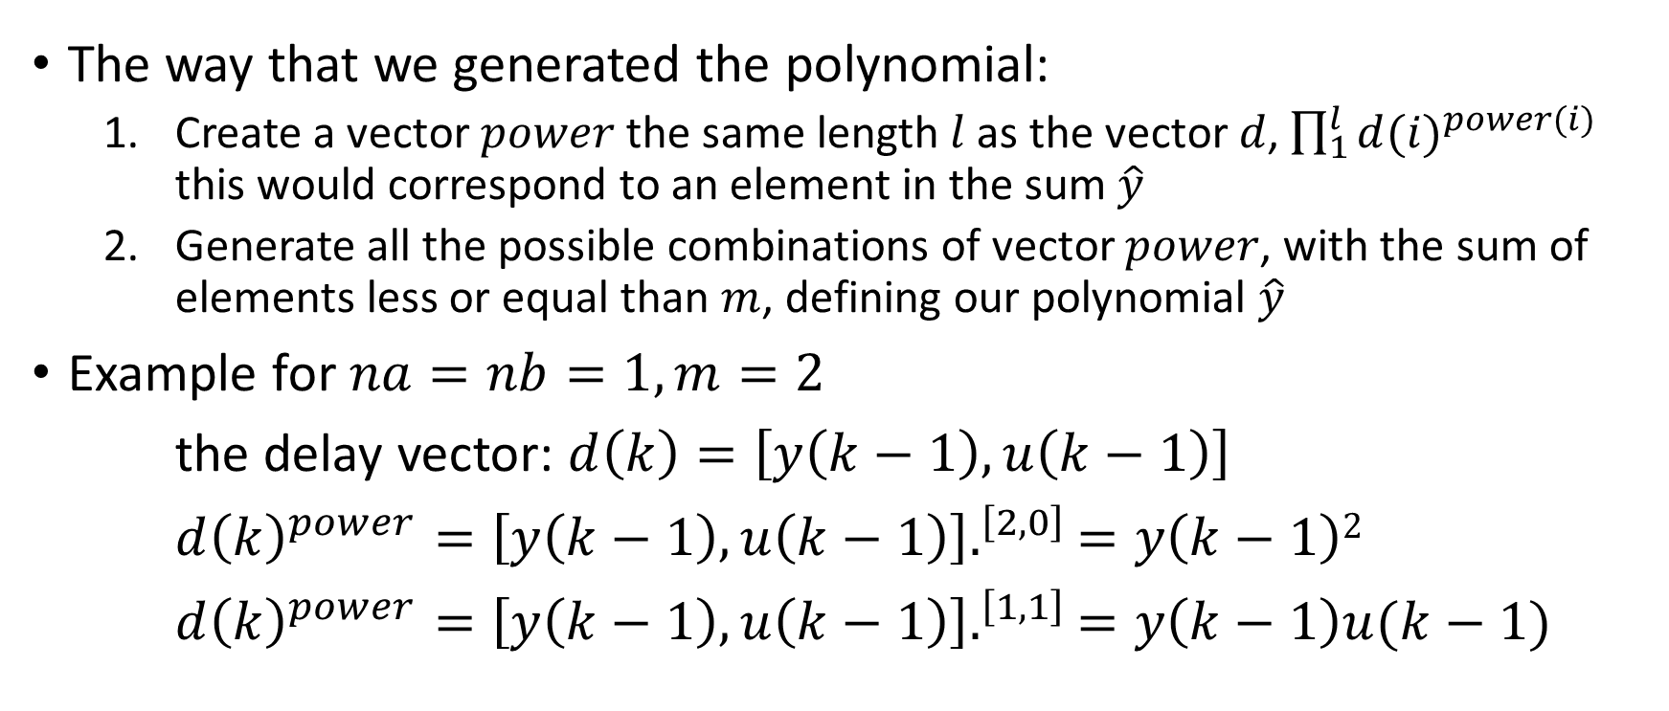
Finding the parameters
The way that we generated the polynomial:
Create a vector $power$ the same length $l$ as the vector $d$, $\prod_{1}^{l}{{d(i)}^{power(i)}}$ this would correspond to an element in the sum $\hat{y}$
Generate all the possible combinations of vector $power$, with the sum of elements less or equal than $m$, defining our polynomial $\hat{y}$
Example for $na=nb=1, m=2$
the delay vector: $d\left(k\right)=\left[y\left(k−1\right),u\left(k−1\right)\right]$
$d{\left(k\right)}^{power}={\left[y\left(k−1\right),u\left(k−1\right)\right].}^{\left[2,0\right]}=y\left(k−1\right)2$
$d{\left(k\right)}^{power}={\left[y\left(k−1\right),u\left(k−1\right)\right].}^{\left[1,1\right]}=y\left(k−1\right)u(k−1)$

Slide 6
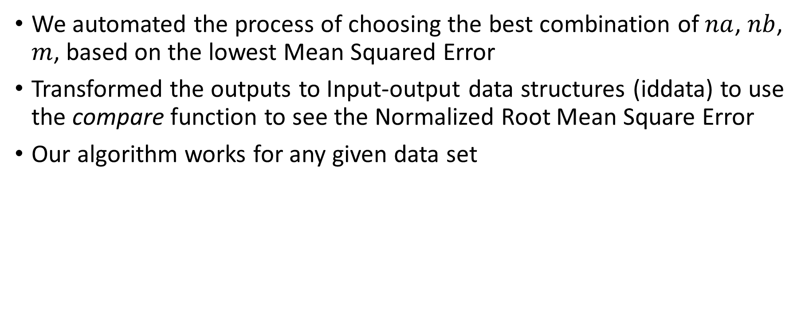
Key features
We automated the process of choosing the best combination of $na$, $nb$, $m$, based on the lowest Mean Squared Error
Transformed the outputs to Input-output data structures (iddata) to use the compare function to see the Normalized Root Mean Square Error
Our algorithm works for any given data set

Slide 7
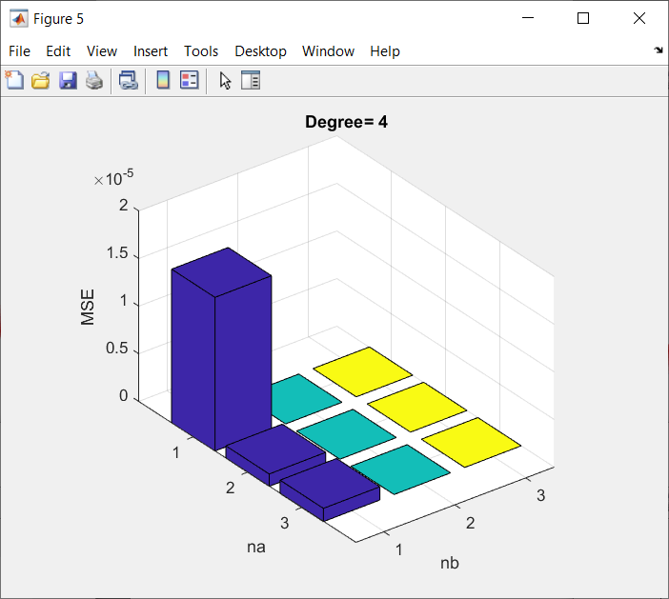
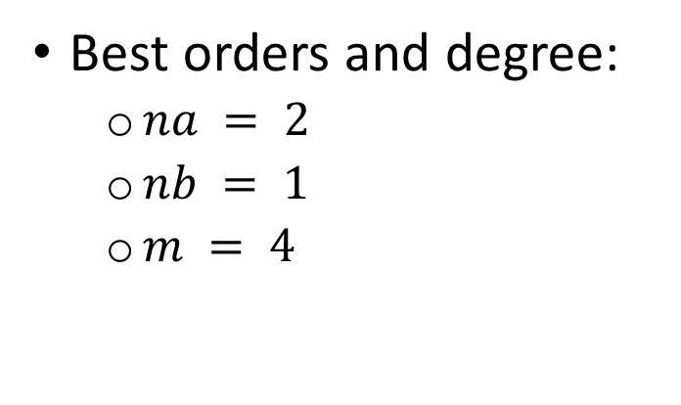
Tuning Results
Best orders and degree:
$na = 2$
$nb = 1$
$m = 4$

Slide 8
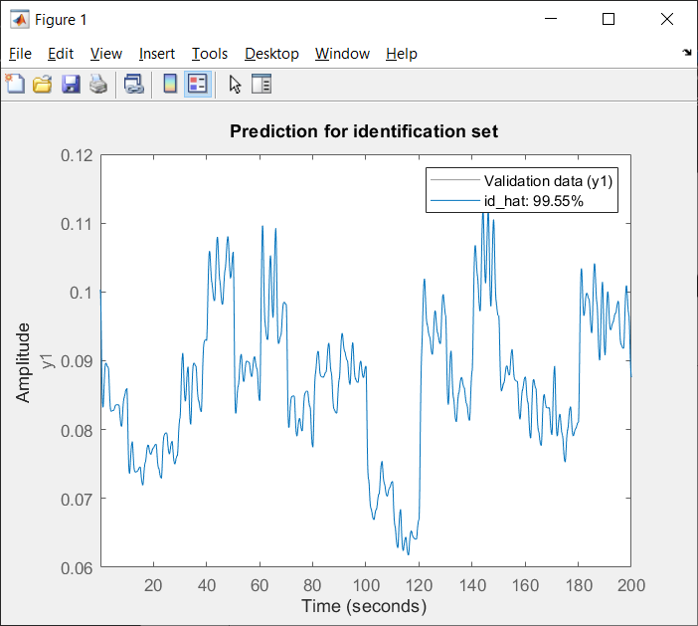

Plots for the optimal value Identification data
MSE = 2.187e-09
MSE = 4.786e-08

Slide 9
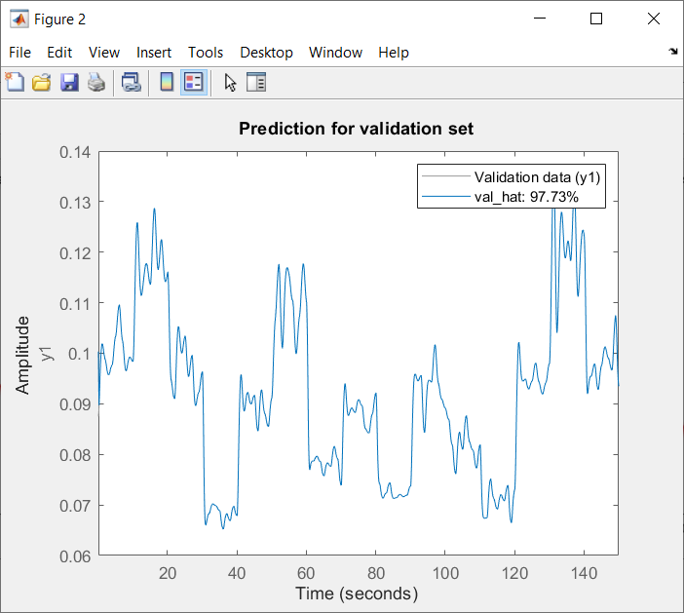
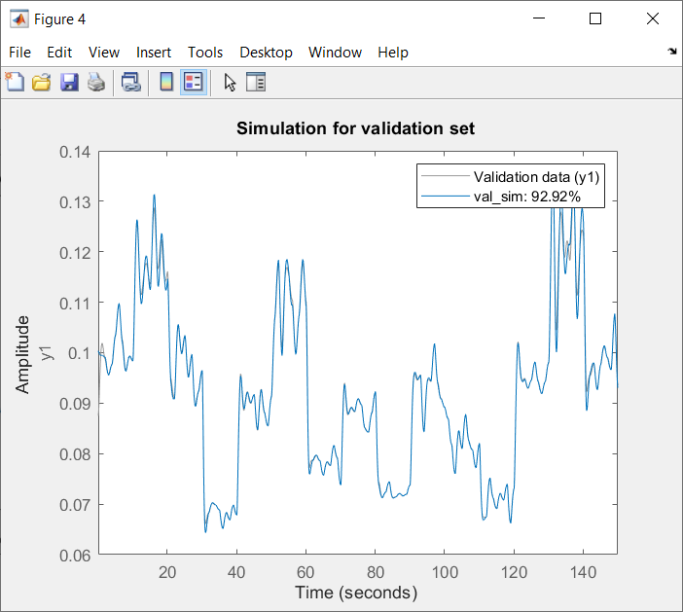
Validation data
MSE = 1.332e-07
MSE = 1.291e-06

Slide 10
Conclusions
Using the narx method we can identify easier black box systems concluding that narx is a great method of finding the best model for the data set given
We managed to find the model that is the closest to the real one
We found an efficient algorithm to generate the polynomial p

Slide 11
List of code
function [phi] = compPhi(na,nb,u,y,powerMatrix)
phi = [];
for k = 1:length(u)
elements = [];
for i = 1:na
if k - i > 0
elements = [elements y(k-i)];
else
elements = [elements 0];
end
end
for i = 1:nb
if k - i > 0
elements = [elements u(k-i)];
else
elements = [elements 0];
end
end
aux = [];
for i = 1:length(powerMatrix)
aux = [aux prod(elements .^ powerMatrix(i,:))];
end
phi = [phi; aux];
end
end
function [MSE] = compMSE(approx, trueVal)
MSE = 0;
for i=1:length(approx)
MSE = MSE + (approx(i) - trueVal(i))^2;
end
MSE = MSE / length(approx);
end

Slide 12
function [y_sim] = compYSim(na, nb, u, PowerMatrix, theta)
y_sim = zeros(length(u),1);
for k = 1:length(u)
line = [];
for i = 1:na
if k - i > 0
line = [line y_sim(k-i)];
else
line = [line 0];
end
end
for i = 1:nb
if k - i > 0
line = [line u(k-i)];
else
line = [line 0];
end
end
aux = [];
for i = 1:length(PowerMatrix)
aux = [aux prod(line .^ PowerMatrix(i,:))];
end
y_sim(k) = aux * theta;
end
end
Function powerGen
function [power_mat] = powerGen(no_inputs, power)
power_mat = [];
aux = zeros(1,no_inputs);
power_mat = aux;
aux(no_inputs) = 1;
power_mat = [power_mat; aux];
while aux(1) ~= power
sum_aux = sum(aux);
changed = 0;
i = length(aux);
while changed == 0
if sum_aux < power
aux(i) = aux(i) + 1;
changed = 1;
else
found = 0;
while found == 0
aux(i) = 0;
aux(i-1) = aux(i-1) + 1;
sum_aux = sum(aux);
if sum_aux <= power
found = 1;
else
i = i - 1;
end
end
changed = 1;
end
end
power_mat = [power_mat; aux];
end
end

Slide 13
Main code
%| Nonlinear ARX Identification |
%|---------------------------------|
%| Petcuț Adrian-Axente |
%|---------------------------------|
%| Ilea Cosmin-Ionuț |
%|---------------------------------|
%| Szakacs Armand-Antonio |
%|---------------------------------|
%| SYSTEM IDENTIFICATION 2023-2024 |
%| TUCN |
%| Project part 2 |
%|---------------------------------|
clear all;
close all;
clc;
load("iddata-11.mat");
% choosing the parameters
na_max=3;
nb_max=3;
m_max=4;
% the time vectors
Ts=id.Ts;
t_id = id_array(:,1);
t_val = val_array(:,1);
u_id = id_array(:,2);
y_id = id_array(:,3);
% the input and output of the validation data
u_val = val_array(:,2);
y_val = val_array(:,3);
% declaring the MSE matrices
mse_prediction_matrix=zeros(na_max*nb_max, m_max);
mse_simulation_matrix=zeros(na_max*nb_max, m_max);
mse_simulation_min=1e200;

Slide 14
for m=1:m_max
for na=1:na_max
for nb=1:nb_max
% generation the matrix with powers
pow_matrix = powerGen(na+nb, m);
% computing phi for identification data
phi_id = compPhi(na, nb, u_id, y_id, pow_matrix);
% computing theta
theta = phi_id\y_id;
% computing phi for validation data
phi_val = compPhi(na, nb, u_val, y_val, pow_matrix);
% the one step ahead prediction for validation
y_hat_val = phi_val * theta;
% computing the simulation for validation
y_sim_val = compYSim(na, nb, u_val, pow_matrix, theta);
% computing the MSE for prediction
mse_prediction = compMSE(y_hat_val, y_val);
% computing the MSE for simulation
mse_simulation = compMSE(y_sim_val, y_val);
% save the MSE values in matrices (each collum represents a value
% of m)
mse_prediction_matrix((na-1)*nb_max + nb, m) = mse_prediction;
mse_simulation_matrix((na-1)*nb_max + nb, m) = mse_simulation;
if mse_simulation<mse_simulation_min
mse_prediction_min = mse_prediction;
mse_simulation_min = mse_simulation;
na_best_fit = na;
nb_best_fit = nb;
m_best_fit = m;
end
end
end
end
%get the best MSE depending on na and nb
na = na_best_fit;
nb = nb_best_fit;
m = m_best_fit;

Slide 15
% computing the MSE for prediction
mse_prediction_id = compMSE(y_hat_id, y_id);
% computing the MSE for simulation
mse_simulation_id = compMSE(y_sim_id, y_id);
f1 = figure;
movegui(f1, 'northwest');
id_hat = iddata(y_hat_id,u_id,Ts);
compare(id,id_hat);
title("Prediction for identification set");
f2 = figure;
movegui(f2, 'southwest');
val_hat = iddata(y_hat_val,u_val,Ts);
compare(val,val_hat);
title("Prediction for validation set");
f3 = figure;
movegui(f3, 'northeast');
id_sim = iddata(y_sim_id,u_id,Ts);
compare(id,id_sim);
title("Simulation for identification set");
f4 = figure;
movegui(f4, 'southeast');
val_sim = iddata(y_sim_val,u_val,Ts);
compare(val,val_sim);
title("Simulation for validation set");
% generation the matrix with powers
pow_matrix = powerGen(na+nb, m);
phi_id = compPhi(na, nb, u_id, y_id, pow_matrix);
% computing theta
theta = phi_id\y_id;
% computing phi for validation data
phi_val = compPhi(na, nb, u_val, y_val, pow_matrix);
% the one step ahead prediction for validation
y_hat_val = phi_val * theta;
% computing the simulation for validation
y_sim_val = compYSim(na, nb, u_val, pow_matrix, theta);
% computing the simulation for identification
y_sim_id = compYSim(na, nb, u_id, pow_matrix, theta);
% the one step ahead prediction for identification
y_hat_id = phi_id * theta;

Slide 16
f5 = figure;
movegui(f5, 'north')
% taking the collum with the best MSE from mse_simulation matrix and
% computing matrix z (rows represent values for na and collums for nb
vect = mse_simulation_matrix(:, m_best_fit)';
z = [];
for i = 1:na_max
z = [z; vect((i-1)*na_max+1:i*na_max)];
end
bar3(z);
xlabel('nb');
ylabel('na');
zlabel('MSE');
title(['Degree= ' num2str(m_best_fit)]);

